Slide 1
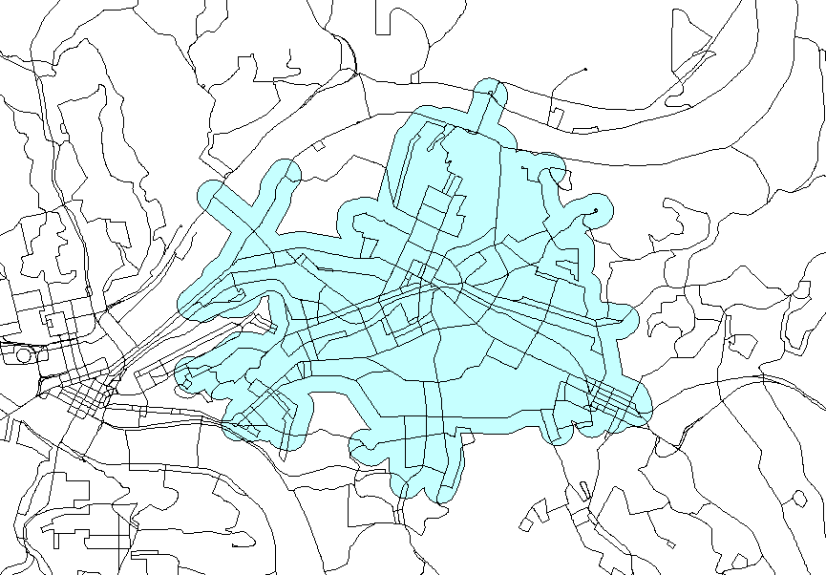
GIS Lecture 9
Spatial Analysis

Slide 2
Outline
Proximity Buffers
    Points
    Lines
    Polygons
Spatial Joins on Buffers
Visual Basic Scripts
Apportioning Non-Coterminous Polygons

Slide 3
Proximity Buffers

Slide 4

Proximity
Buffers Created
  Points
  Lines
  Polygons

Slide 5
Points
Buffer created by assigning a buffer distance around points

Slide 6
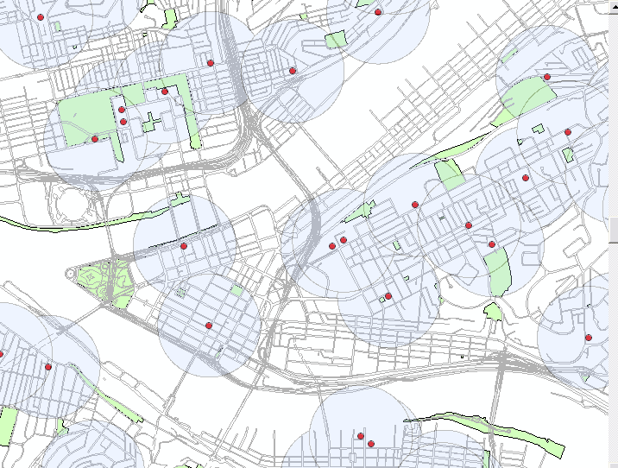
Point Buffer Example
- Polygon buffer created ¼ mile around schools

Slide 7
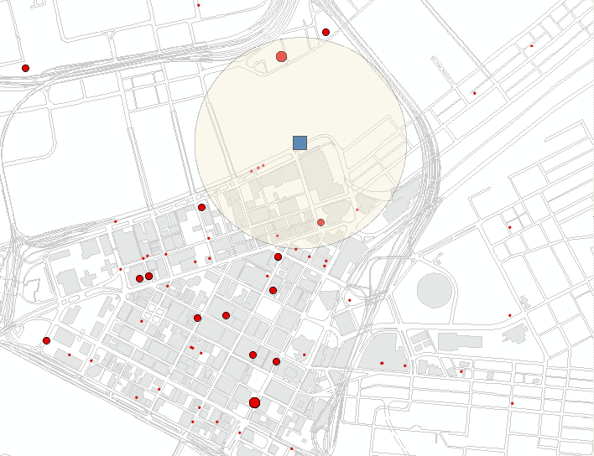
Point Buffer Example
Technology Businesses that are with ¼ mile of Convention Center

Slide 8
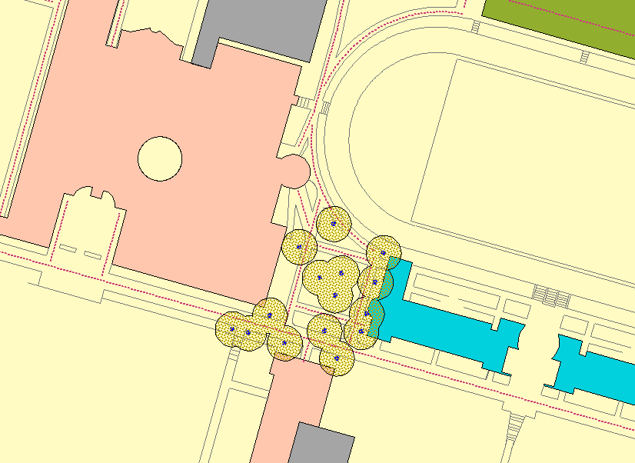
Point Buffer Example
- Polygon buffer created 20’ around lights
- Shows what areas will be lit in a parking lot

Slide 9
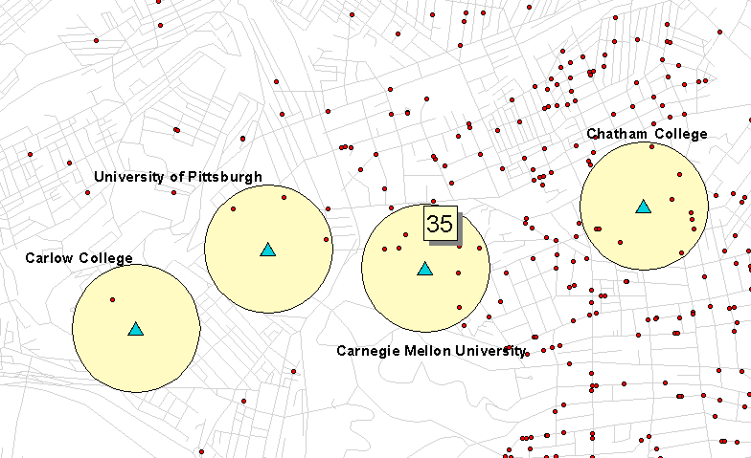
Spatial Join - Buffers
Count Faculty and Staff within ¼ mile of University
  Spatially join buffers to points
  Summarize to count the number of faculty and staff in ¼ mile buffer
  Join the buffer count back to the buffer polygon

Slide 10
Lines
Buffer created by assigning a buffer distance around lines

Slide 11
Line Buffer Example
Access-to-Work Study (Pittsburgh Foundation)
- Polygon buffer created around PAT Bus Routes
- Shows 15 minute ride times

Slide 12
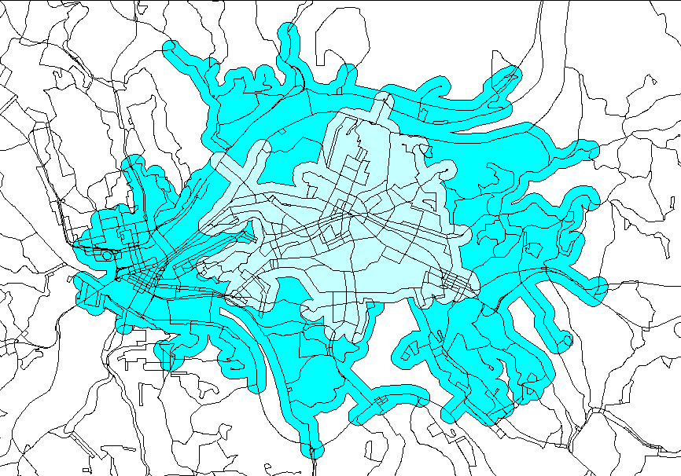
Line Buffer Example
Another buffer shows 30 minute ride times

Slide 13
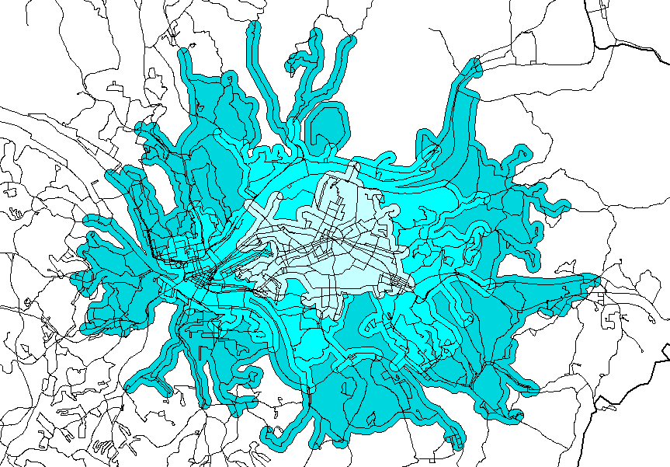
Line Buffer Example
…45 minutes

Slide 14
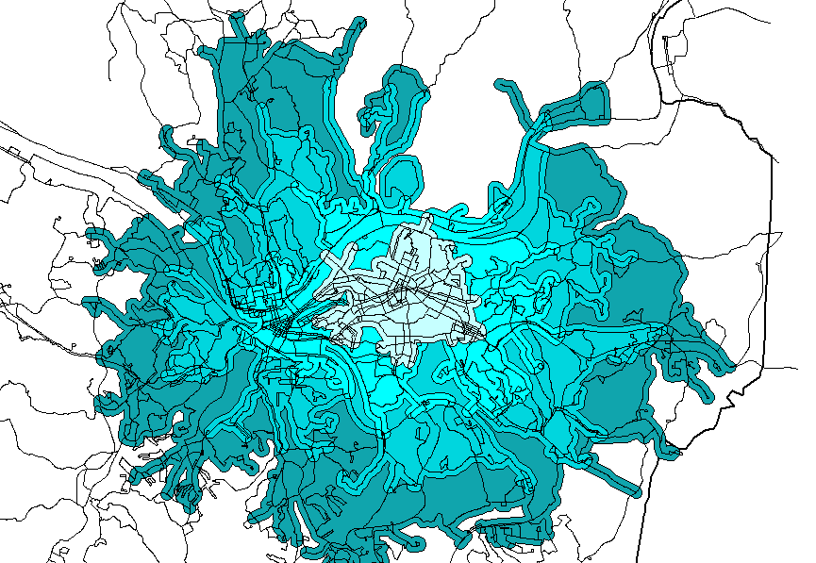
Line Buffer Example
…60 minutes

Slide 15
Polygons
Buffer created by assigning a buffer distance around polygons

Slide 16
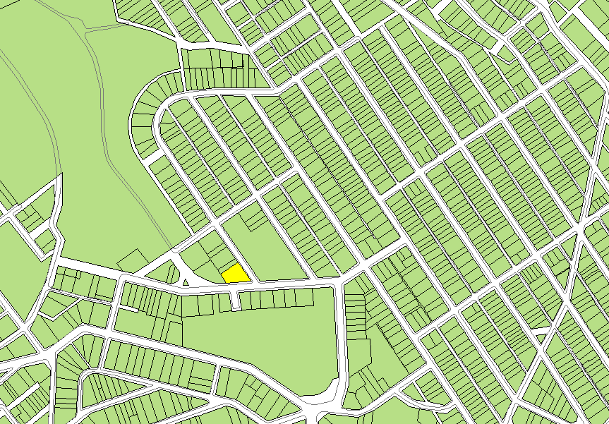
Parcels within 150’ of selected item

Slide 17
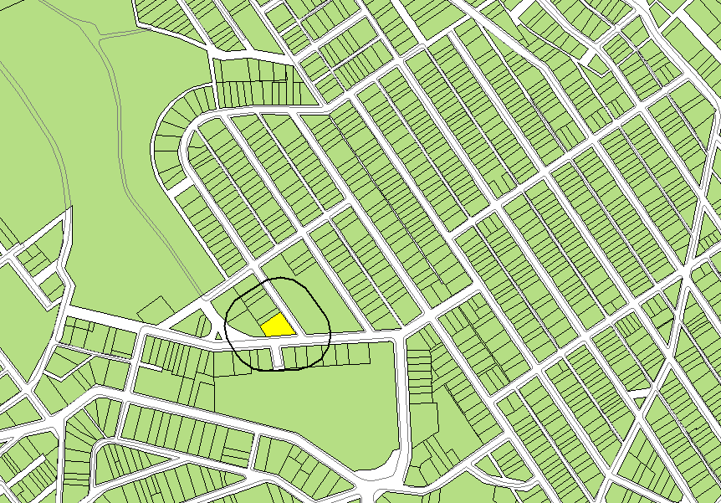
Buffer is Created

Slide 18
Buffers
Buffers Created
  Points
  Lines
  Polygons

Slide 19
Visual Basic Scripts

Slide 20
Visual Basic Scripts
  Adding Area and Perimeter to Polygons
  Finding Polygon Centroids

Slide 21
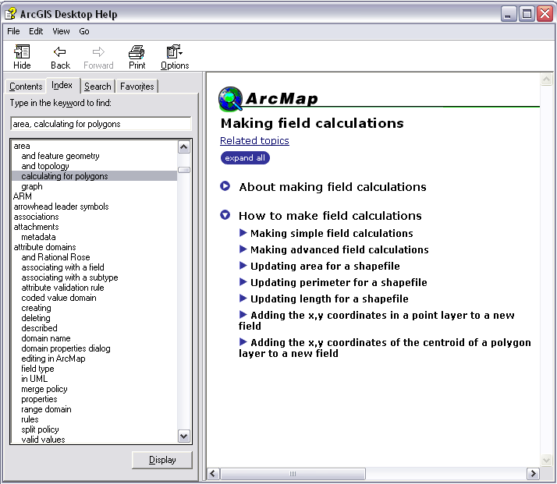
Area and Perimeter VB Script
  Advanced calculations for finding area, perimeter, and length of features

Slide 22
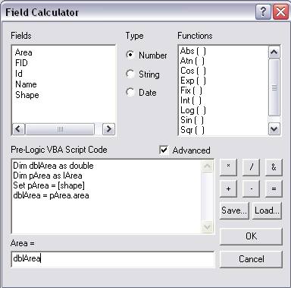
Area and Perimeter VB Script
  Add field in shapefile (e.g. area)
  Use calculator function and Visual Basic Script to calculate polygon areas

Slide 23
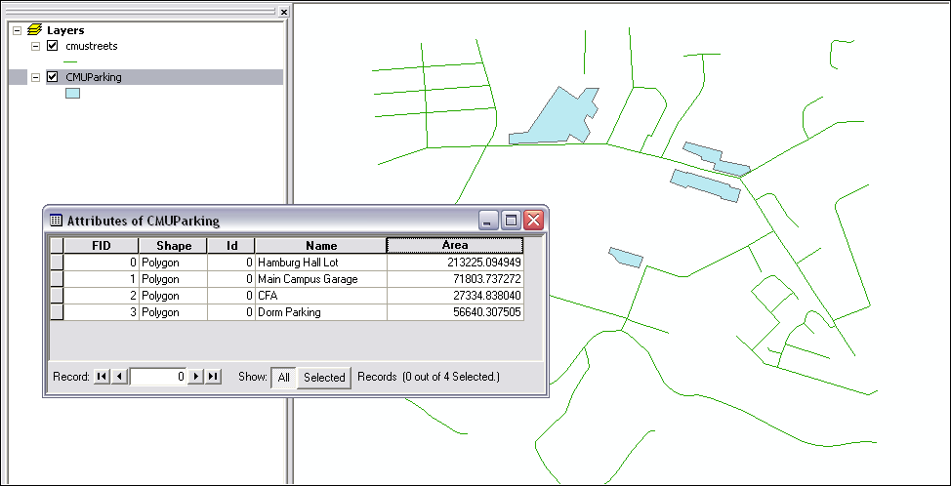
Area and Perimeter VB Script
  Result is the area of each polygon feature

Slide 24
Visual Basic Scripts

Slide 25
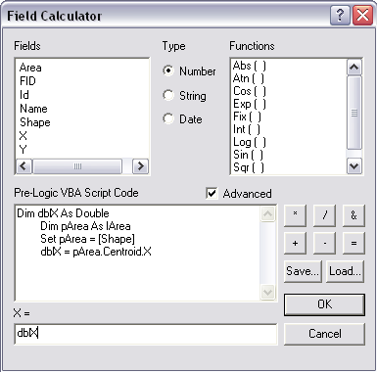
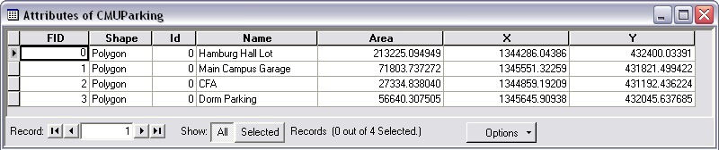
Polygon Centroids
  Advanced calculations for finding polygon centroids
  Added as an XY Data Layer

Slide 26
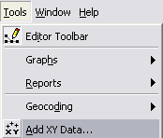
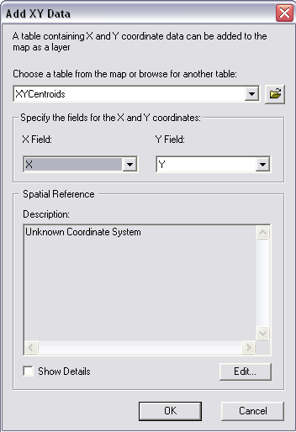
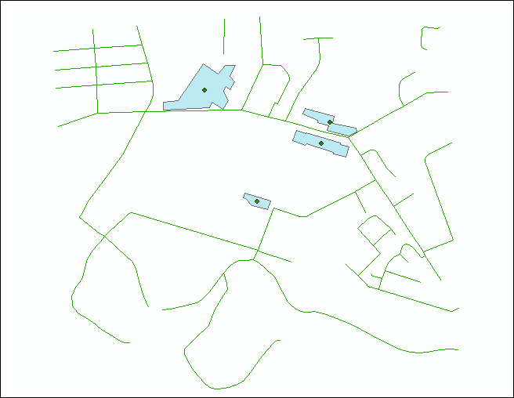
Polygon Centroids
  Show the centroids of a polygon
    Export attributes as table
    Add as XY Data

Slide 27
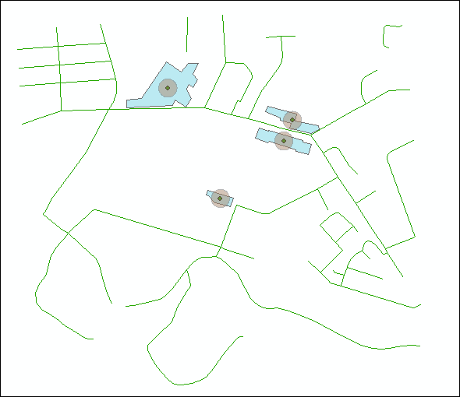
Polygon Centroids
  Create buffers around centroids

Slide 28
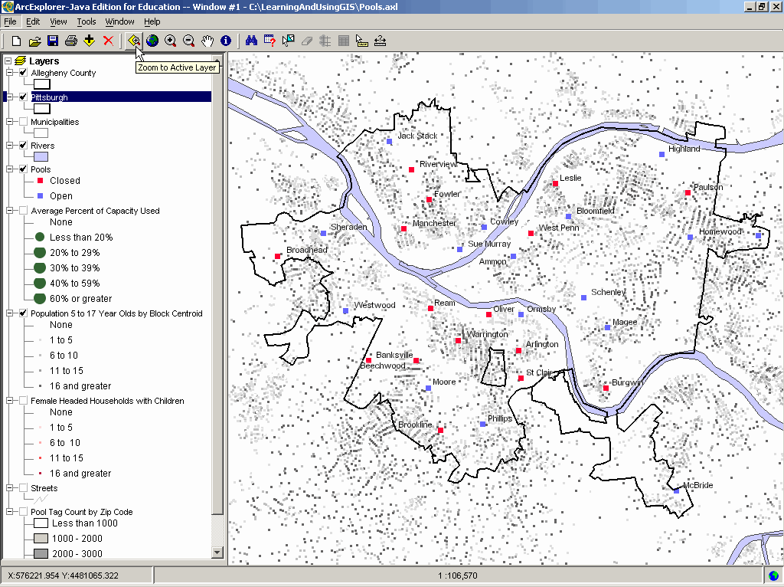
Polygon Centroids

Slide 29
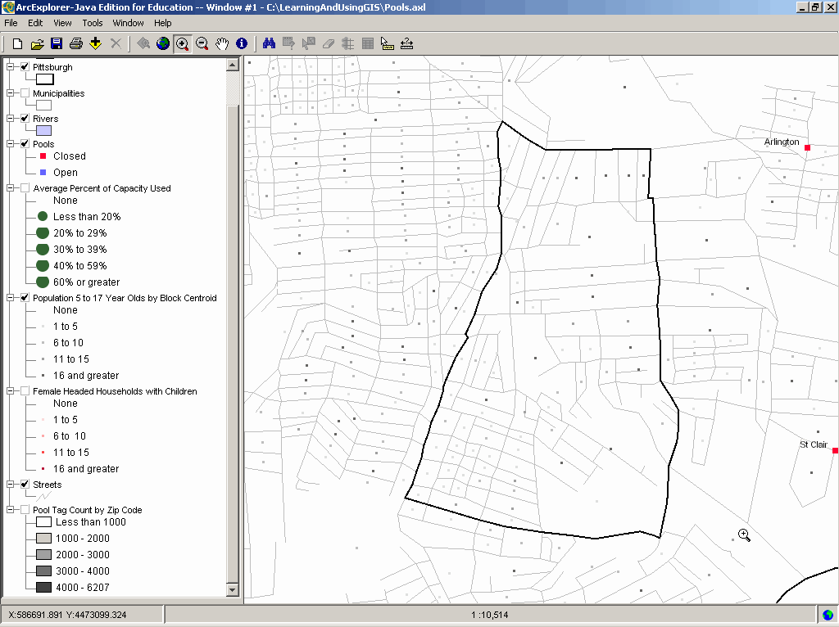
Polygon Centroids

Slide 30
Apportionment

Slide 31
Examples of apportionment
You want to know the population of a ZIP code but only have census tracts
Approximate the population of zip codes using Census Tracts or Blocks

Slide 32
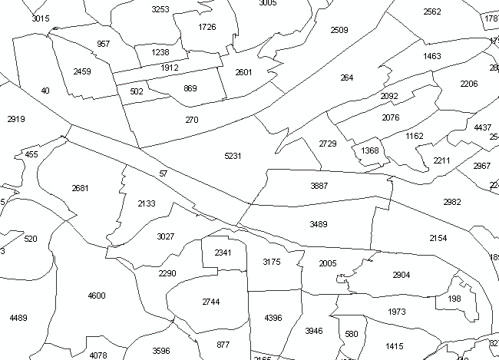
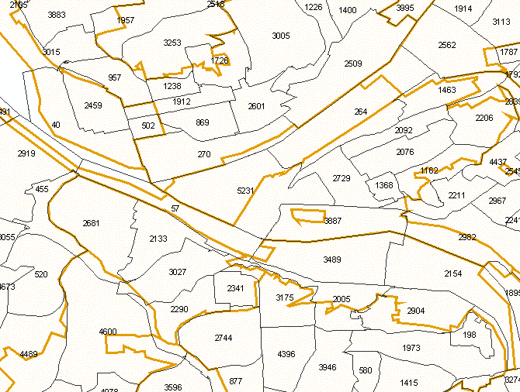
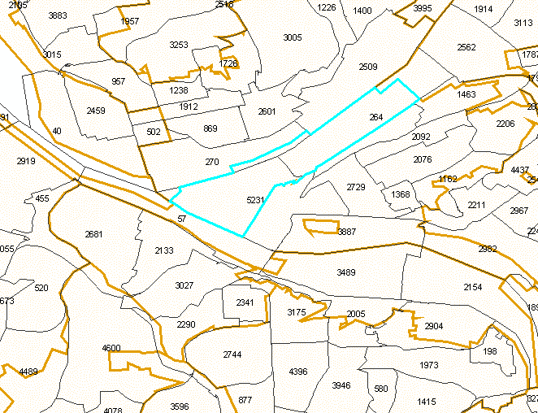
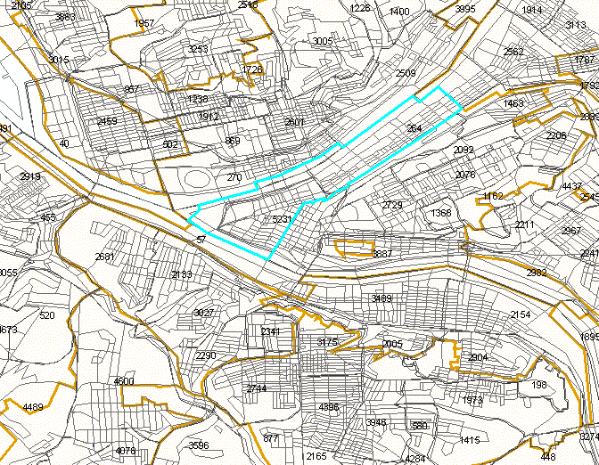
Population Apportionment
Begin with census tract population
Overlay zip codes which are non-coterminous
Use apportionment to estimate the population in each census tract
Use census blocks for better estimates

Slide 33
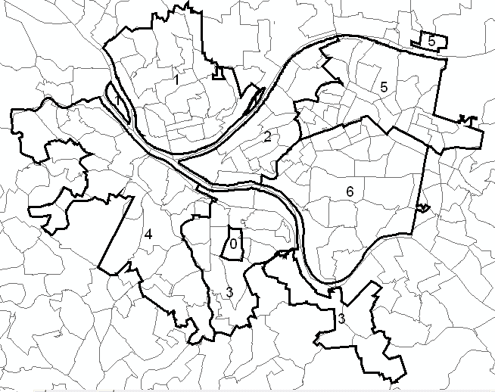
Other examples of apportionment
Approximate the population of police zones by using Census Tracts or Blocks

Slide 34
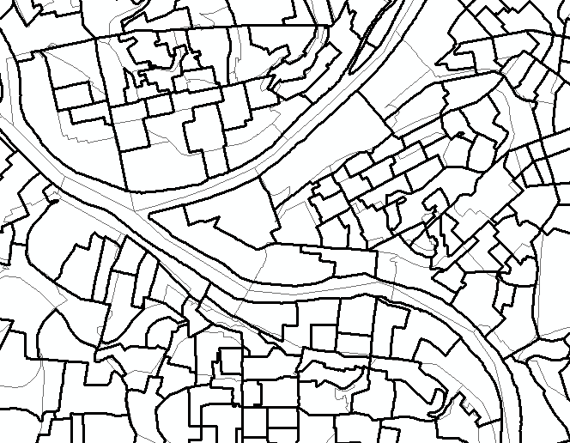
Other examples of apportionment
Approximate the population of voting districts by using Census Tracts or Blocks

Slide 35
Other census data to apportion…
Population (tract and block)
Race (tract and block)
Housing Units (tract and block)
Educational Attainment (tract only)
Income (tract only)
Poverty Status (tract only)
Others?

Slide 36
Tutorial Example: Apportion Data for Non-Coterminous Polygons
  Problem:
    Police want to know the number of under-educated persons (over Age22) in their car beats
    Under-educated data is located in Census tracts (not car beat polygons)
    Census tracts and car beats are non-coterminous

Slide 37
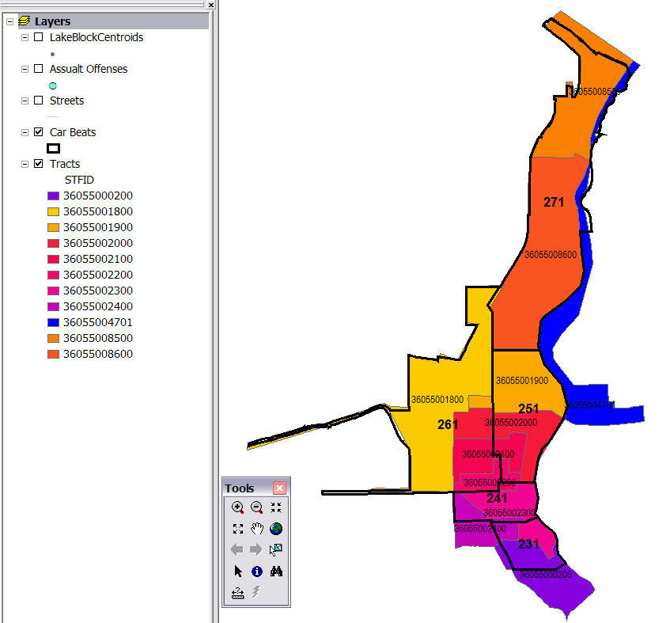
Apportion Data for Non-Coterminous
Polygons
Apportioning (makes approximate splits) of each tract’s data to two or more car beats.

Slide 38
Approach to Apportionment
Several alternatives for apportioning data
    -by area (polygons)
    -length of street network (arcs/lines)
    -block centroids (points)

Slide 39
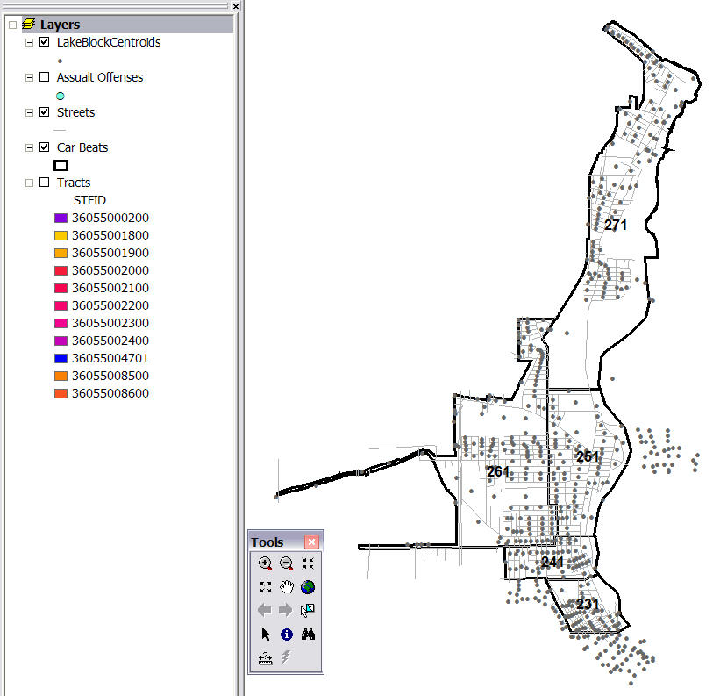
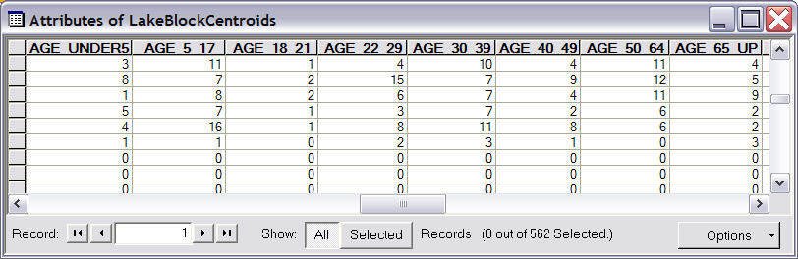
Approach to Apportionment
  Better to use Census Block data
    Areas are smaller than
    Census Tracts (better population estimates)
    Dots are centroids
    of census blocks
    Each dot has census
    data attached to it
    Centroids DO NOT
    have the under-educated
    data, census tracts do
Notes:
We assume that the variable being apportioned, in our case the number of persons 25 or older who have less than a high school education at the tract level, is spatially distributed within the census tract proportionally to general population aged 22 or older at the block level.
We use block centroids instead of block polygons because the block are relatively small and thus can be safely represented by points to make the spatial data processing easier.

Slide 40
Approach to Apportionment
  Review:
  Car beats and census tracts intersect
  Census tracts have under-educated data
  Census blocks have population data (and are smaller than census tracts, thus better to apportion)

Slide 41
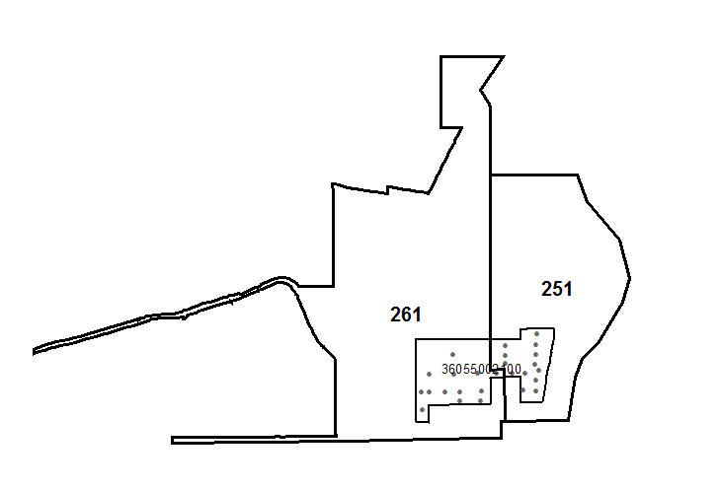
The Math of Apportionment
  Zoomed view of 2 car beats and one tract
    Beat 261 and 251
    Tract 360550002100

Slide 42
The Math of Apportionment
  Tract 360550002100
    has 205 persons aged 25 or older with less than a HS education
    26 block centroids span 2 beats
13 block centroids
Lie in beat 261
Pop. >22=1,177
13 block centroids
Lie in beat 251
Pop. >22=1,089
  Total Population=2,266

Slide 43
The Math of Apportionment
  Apportionment assumes that the fraction of under educated persons 25 or older is the same as that for the general population aged 25 or older:
    Beat 261: 1,177/2,266 = 0.519
    Beat 251: 1,089/2,266 = 0.481

Slide 44
The Math of Apportionment
  205 is the number of under-educated people in tract 36055002100.
  Thus we estimate the contribution of tract 36055002100 to car beat 261’s under-educated population to be (1,177/2,266)x205 = 106. For car beat 251 it is (1,089/2,266)x205 = 99.
  To calculate this in
  GIS, we need to perform
  intersects and joins…

Slide 45
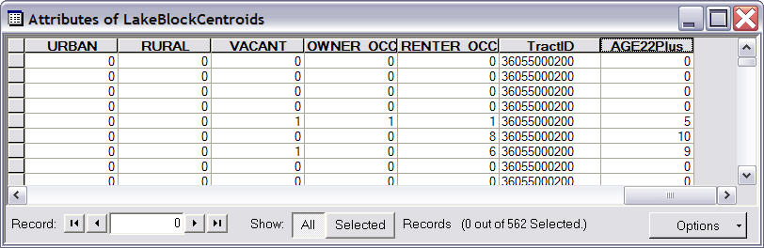
Apportionment Steps
  Block Centroids
    Add two fields: TRACTID and SumAge22
      TRACTID is a the census tract ID numbers (for later joins and summaries)
      SumAge22 is the summary of population Age22+ (calculating multiple age columns)

Slide 46
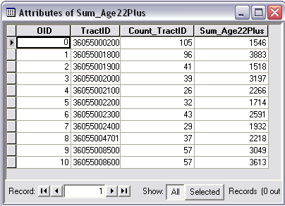
Apportionment Steps
  From the block centroids, create a new summary table counting the number of persons Age22+ for each census tract

Slide 47
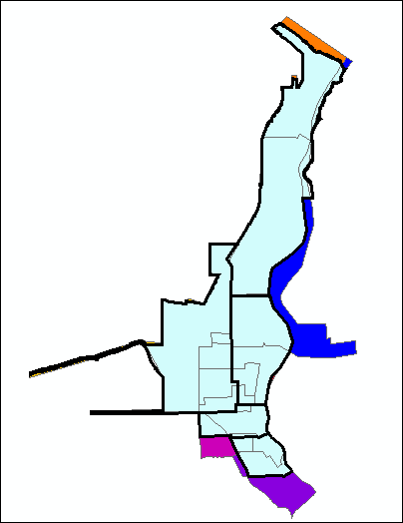
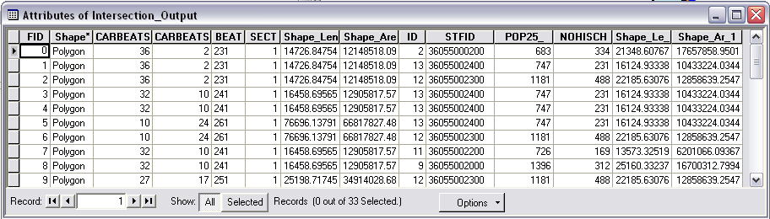
Apportionment Steps
  Create a new layer intersecting car beats and census tracts
  Fields will include values from both tables

Slide 48
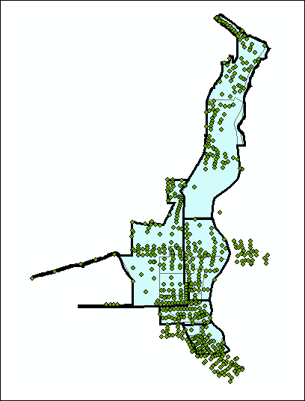
Apportionment Steps
  Spatially join the new intersecting layer of car beats and census tracts (polygons) to block centroids (points)
  New points will have beat and census tract data

Slide 49
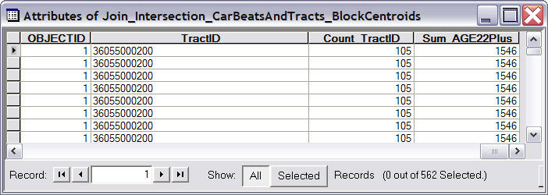
Apportionment Steps
  Join the summary table of Age22 or greater to the newly created points of car beats, census tracts (block centroid points)
  The result is the summary of Age22 or greater population is now on block centroid points

Slide 50
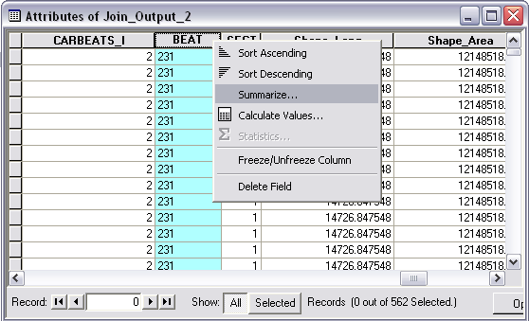
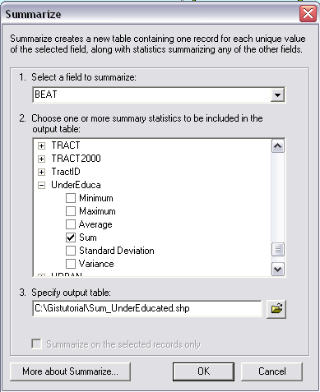
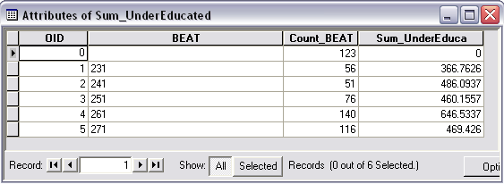
Sum Under-Educated by Car Beats

Slide 51
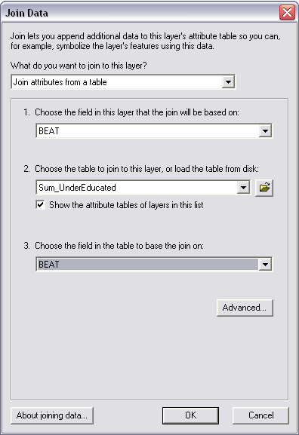
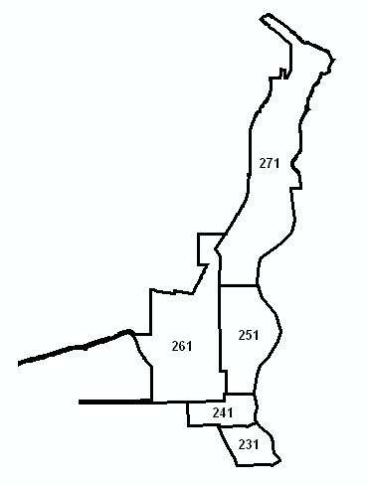
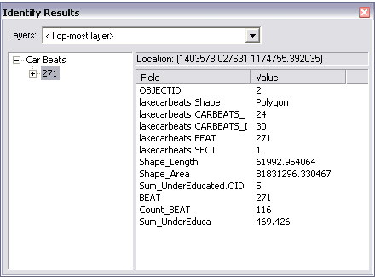
Join to Beats
  Join the sum of under-educated population by car beat to the car beats layer

Slide 52
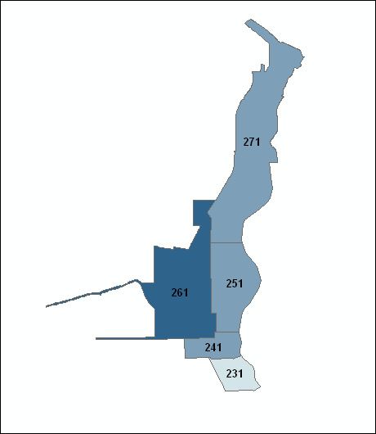
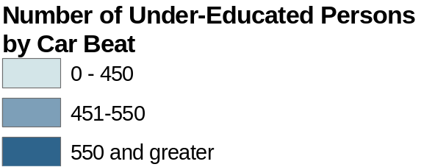
Map Under-Educated by Car Beat

Slide 53
Review
Proximity Buffers
    Points
    Lines
    Polygons
Spatial Joins on Buffers
Visual Basic Scripts
Apportioning Non-Coterminous Polygons

